Slide 1
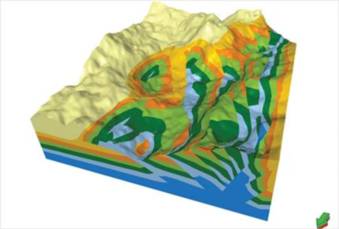
3D geospatial techniques
Rufus Brunt

Slide 2
Intended Learning of lecture and practical
Ability to explain what ‘3D’ is in the digital world
Recap geographical datums and discuss implications for the 3rd dimension
Exploration of GIS data definitions: continuous/ discrete/ raster/ vector
Application of 2D geostatistical techniques within the 3rd dimension

Slide 3
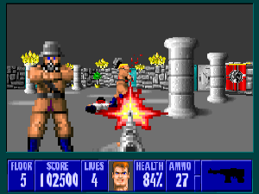
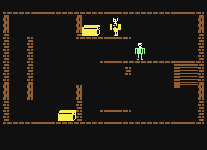
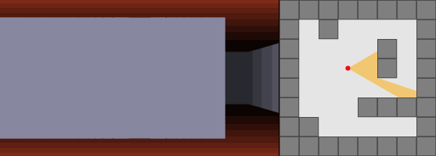
2D vs. 3D
We tend to work on a paper map or flat screen Both are 2D surfaces - So - what is 3D?
Wolfenstein 3D (1991)
One of the first commercial “3D” games
But how 3D is it?
1991
1981
Raycasting: this is a 2D rendering technique to give sprites/ walls the appearance of 3D.
However – the game plays in x, y space. There is no access to the 3rd dimension
Sometimes referred to as 2.5D
I.D. games

Slide 4
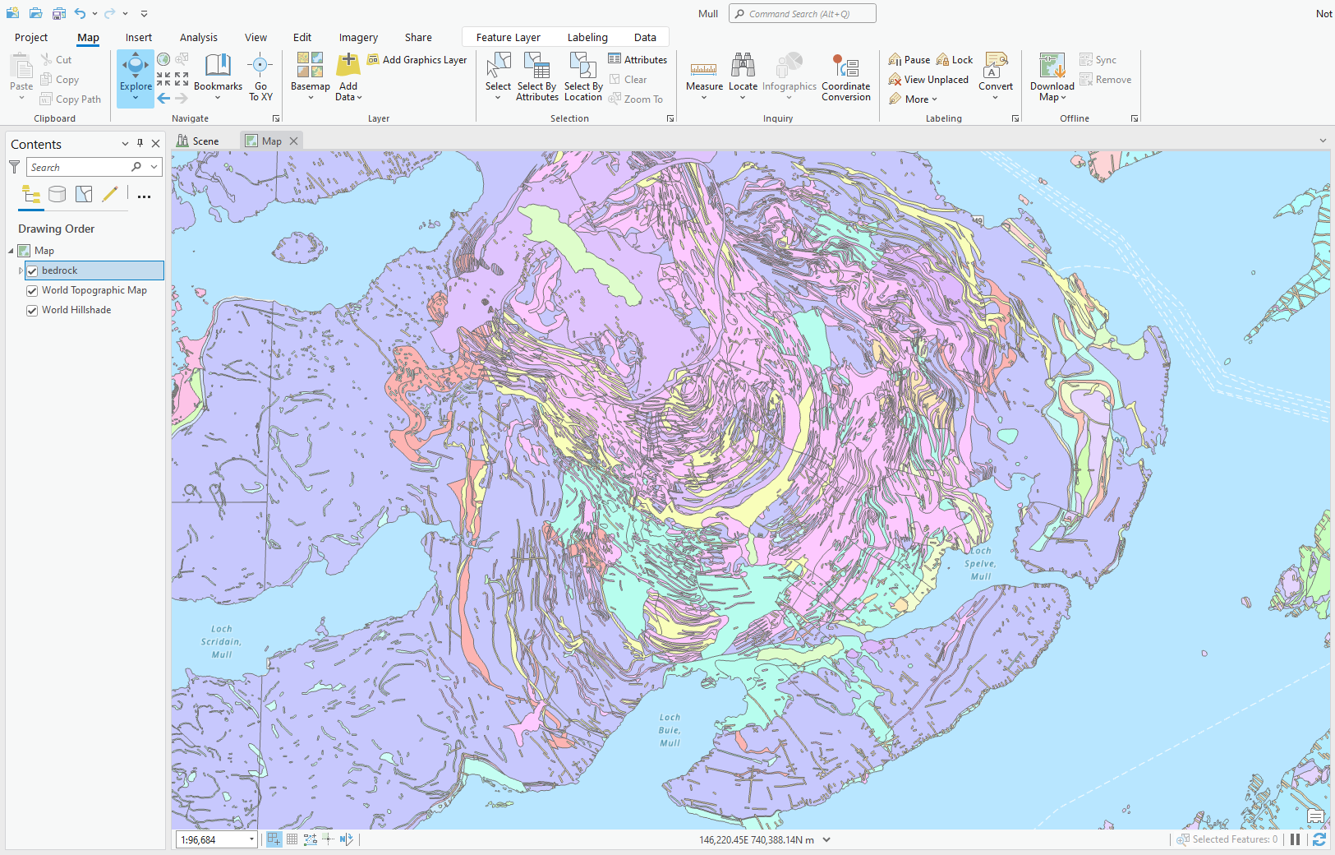
What is meant by 3D?
2D geological map of the Isle of Mull
With x and y coordinates you could find any point on this map

Slide 5
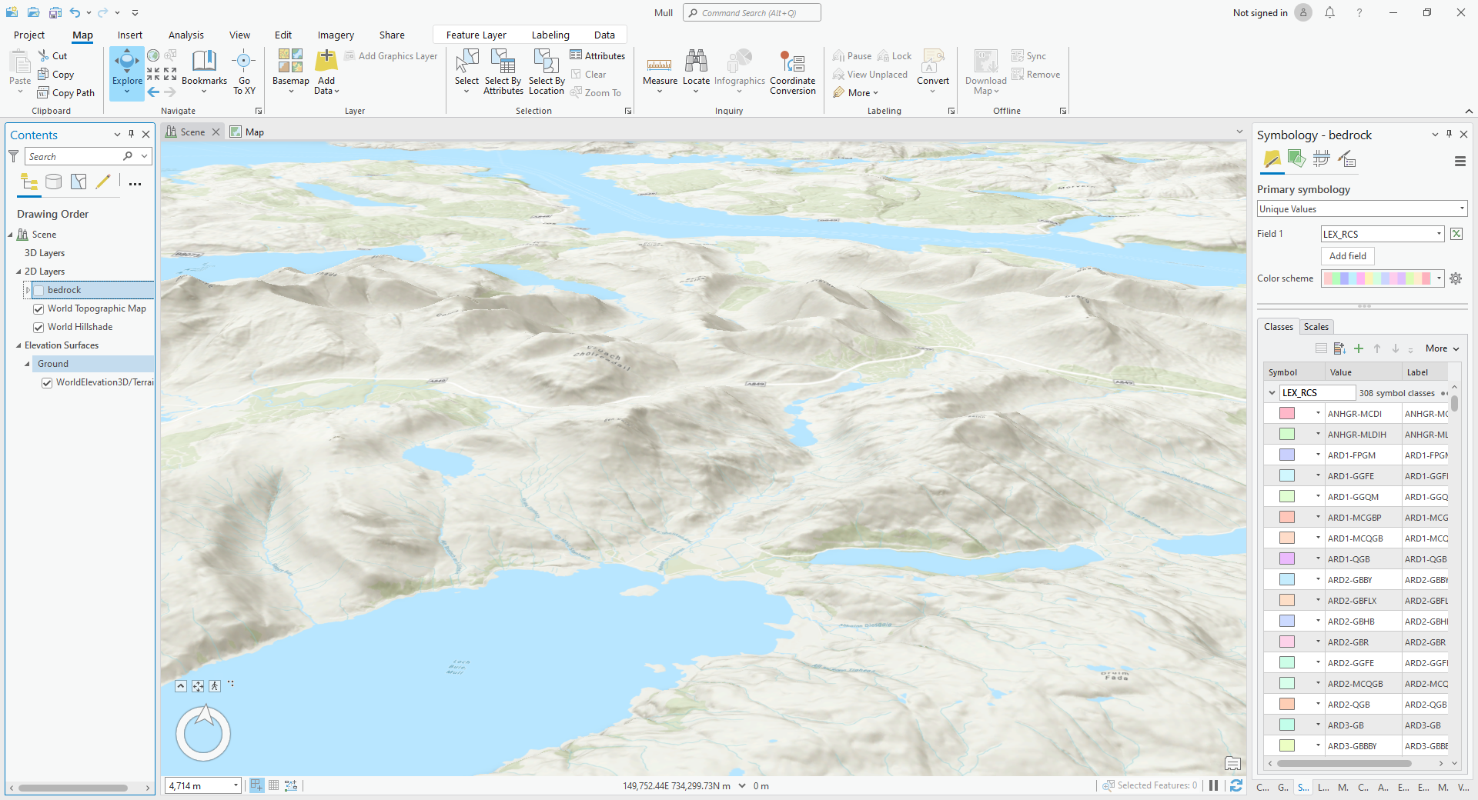
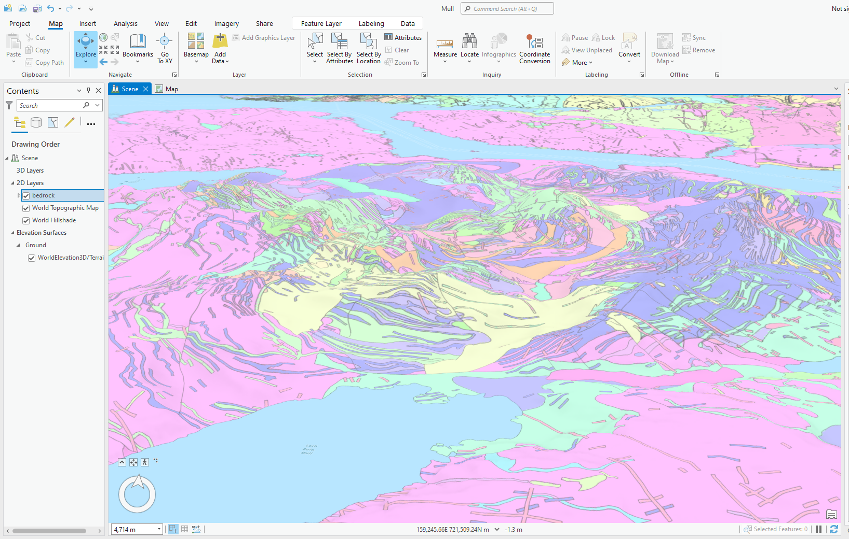
What is meant by 3D?
Digital terrain model (DTM) of the Isle of Mull
Geological map draped over the DTM
Is this 3D?
The map is a surface existing in 3D space. But a point on this surface can still be described using only x and y coordinates.
This is not 3D (mathematically speaking a ‘surface’ is always 2D)

Slide 6
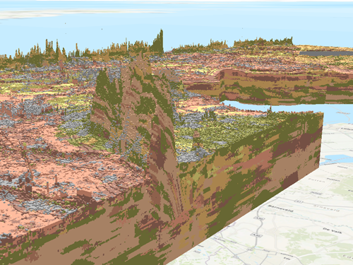
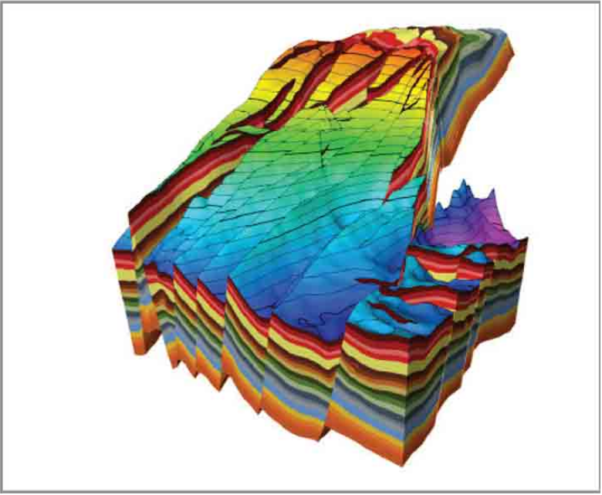
True 3D
ArcGIS: peat distribution model
Petrel:
structural geomodel
Volume is integral in geospatial 3D
To specify a location within these datasets we need to specify x, y and z coordinates.

Slide 7
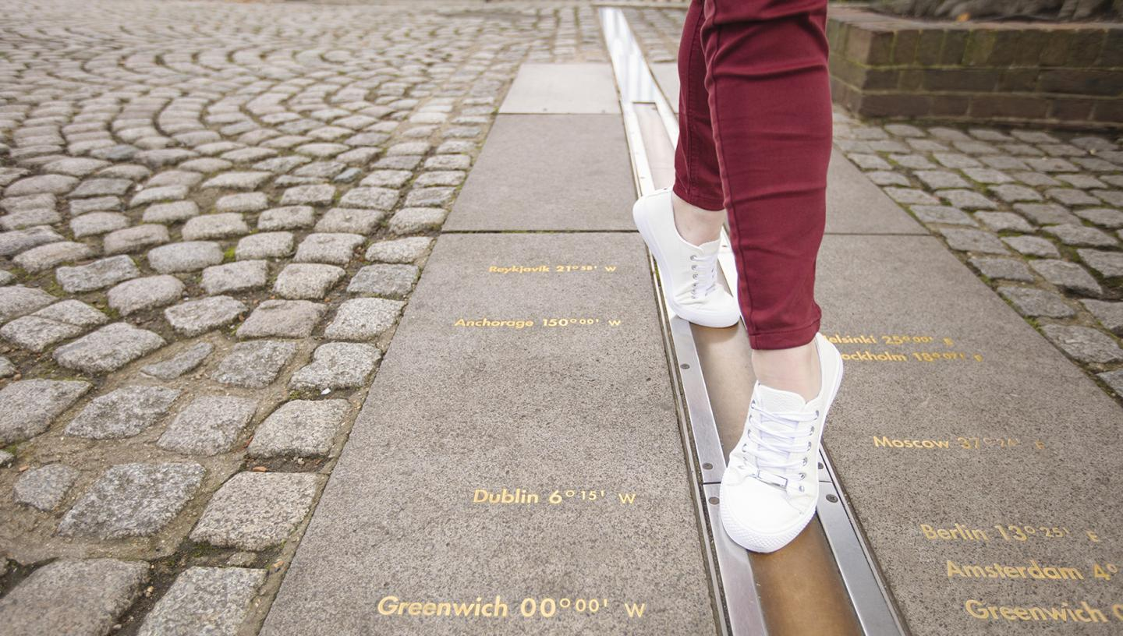
Where do we measure from?
In the lat – long framework:
X is defined by the prime meridian, Greenwich
Y is defined by the equator – the plane equidistant between the Earth’s geographical poles
Z – how do we define height?
Image taken from the Royal museums Greenwich website: https://www.rmg.co.uk

Slide 8
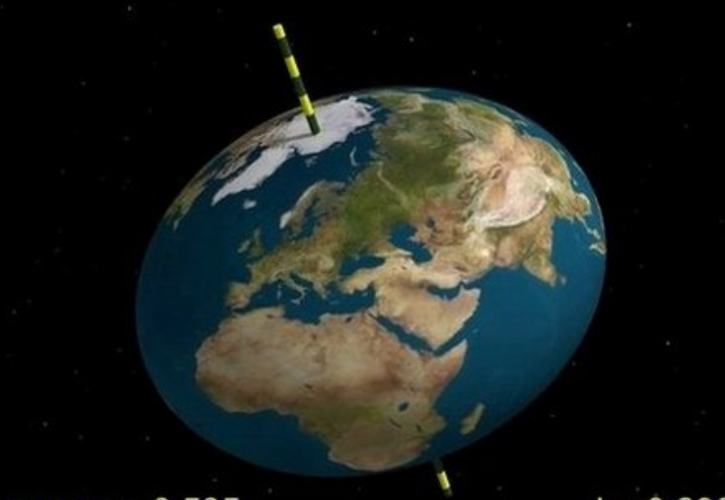
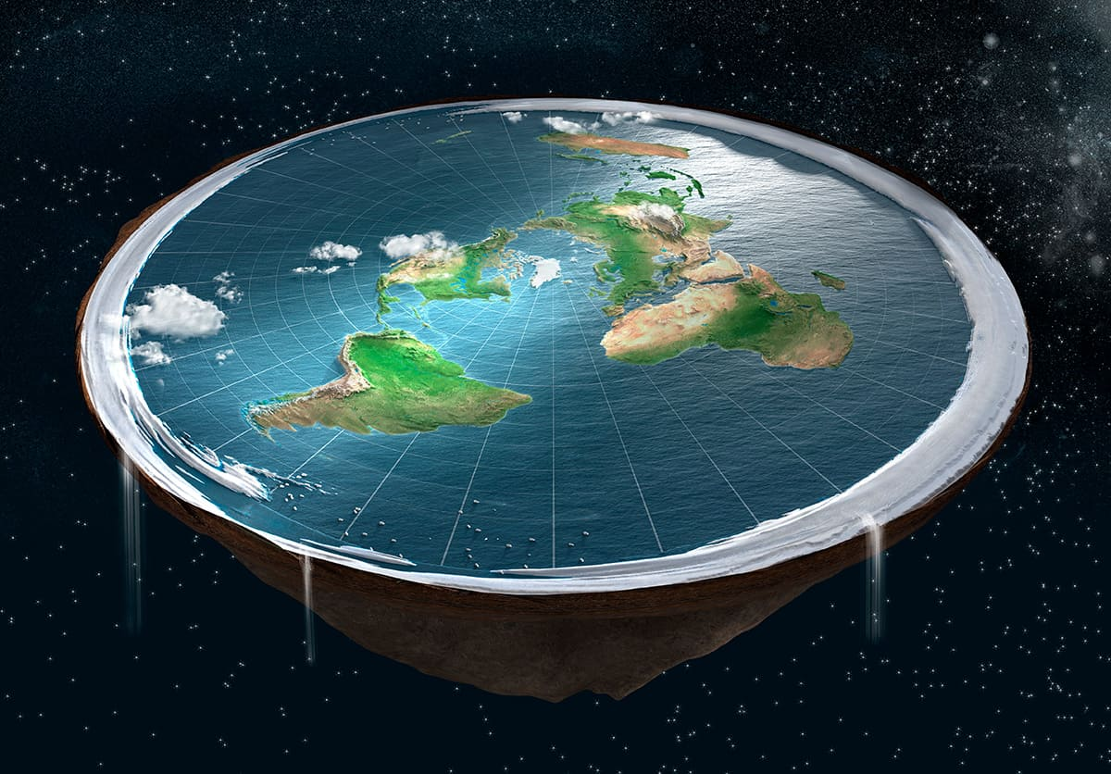
The problematic Z dimension
Earth is not spherical….
Isaac Newton first claimed an oval shape.
  His idea involved wells drilled at the pole and equator and joined at the centre of the Earth.
  He thought if filled with water, the equator well would have to be longer for the system to be in equilibrium.
He ascribed this to angular momentum
Modern measuring methods prove Earth is an oblate spheroid:
  The equatorial diameter is 12,700 km
  The polar diameter is about 40 km shorter
Copyright: Claus Lunau/Science Photo Library
Outcome: distance from the centre of the Earth is not a valid Z

Slide 9
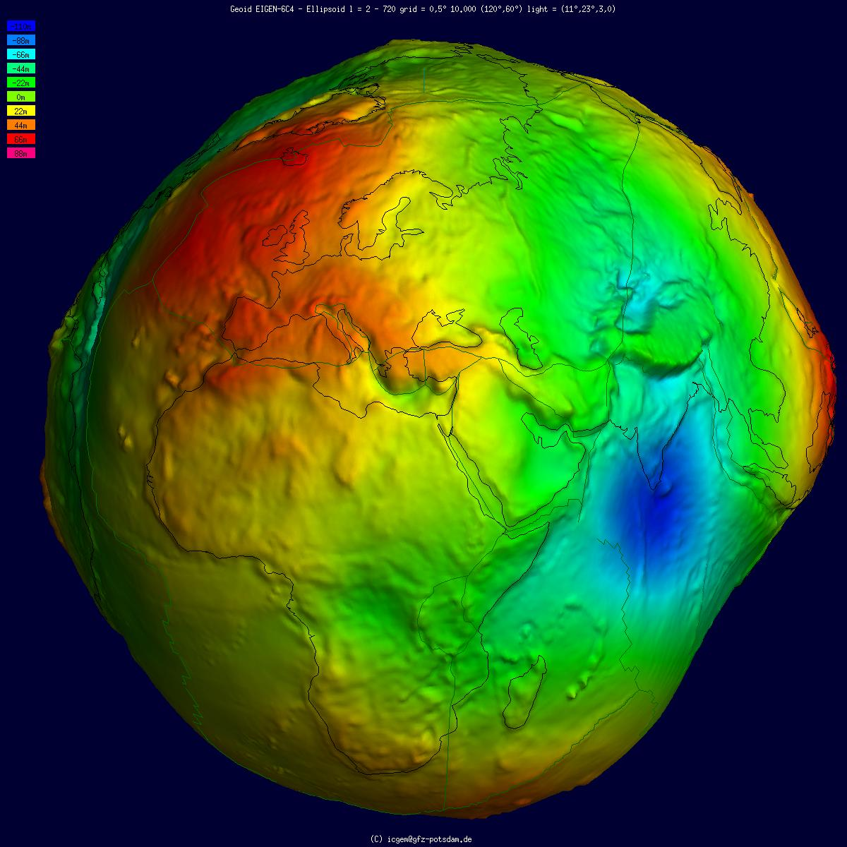
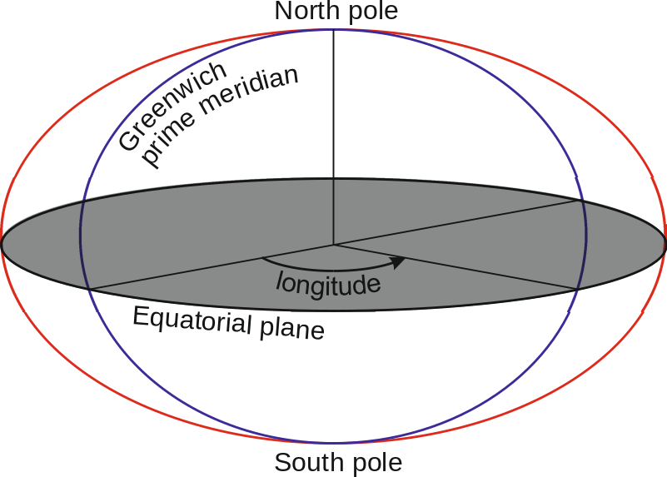
Vertical datums
Geodesy: the science of measuring Earth’s shape, orientation and gravity field
Ellipsoid: an idealised mathematical model of the Earth.
National map grids typically use an ellipsoid closely approximating the local geoid. This work at ‘local’ scale, but is too general for global maps.
Geoid: a gravitational equipotential surface – broadly equivalent to global mean sea level. A complex and constantly changing surface
Affected by:
lithological density
Tides
Plate tectonics
Water depth
Transient crustal heating
etc
red = gravity high
e.g. Europe excess mass due to dense crust and deep Moho;
blue = gravity low
e.g. Sea level is 106m below MSL over the Indian Ocean Geoid low. Caused by hot, low-density mantle plumes (Pal & Ghosh, 2023): https://doi.org/10.1029/2022GL102694
Ince et al, 2019:
http://doi.org/10.5194/essd-11-647-2019
Gravity based Geoid – visual representation with 1000x exaggeration
Reference ellipsoid

Slide 10

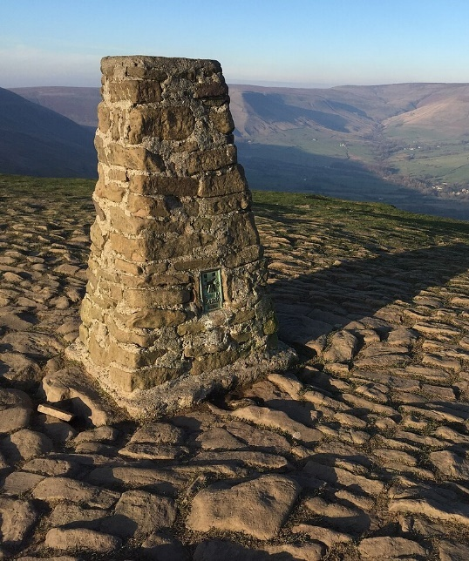
Z measurements
UK ordnance survey
Uses the OSGB36 coordinate reference system: tied to mean sea-level at Newlyn, Cornwall. This is a traditional datum – a triangulation network of trig pillars fitted to the Airy 1830 ellipsoid.
Ordnance Survey GPS permanent network
The more modern OS GPS is tied to
GB ETRS89 (European Terrestrial Reference System 1989) – a version of WGS84 (World Geodetic System 1984).
GPS
In contrast GPS uses the global WGS84 coordinate reference system. This is tied to the global GRS80 ellipsoid (Geodetic Reference System 1980).
Translations
All these systems will produce different z values – and maybe changes in xy. A mathematical transform is needed to convert between coordinate frameworks.
Orthometric height
Topographic surface
Ellipsoid height
Geoid
Ellipsoid
Geoid height
Ocean
Mam Tor trig pillar (Creative commons)
Geoid height

Slide 11

Digital space
VOXELS
PIXELS
z
y
x
Esri
The smallest unit of information in a 2D raster image. In GIS a pixel is a cell in a regular array of data values. Each pixel has an x,y location and set of descriptors such as R,G,B, or height.
A 3 dimensional pixel used to display 3D images.
Each voxel has an x, y, z position and a set of descriptors used to describe volume – or other data such as discrete class, time, density, porosity, etc

Slide 12
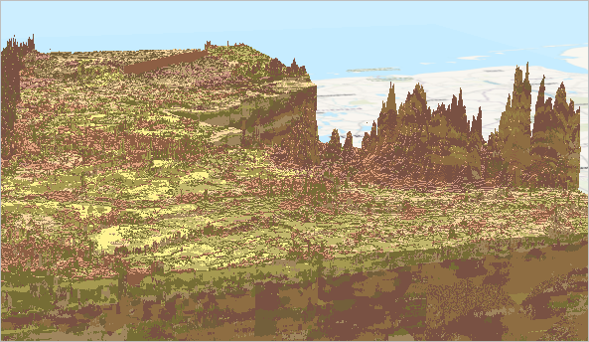
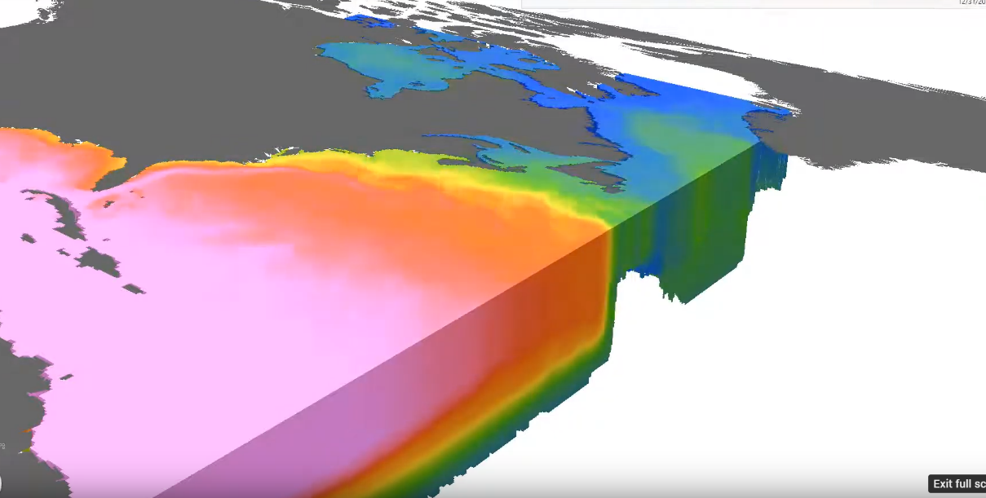
Creating a 3D model
Voxel layers can be created using discrete data or continuous data
Esri: ArcGIS Pro documentation
Esri: ArcGIS Pro documentation
Dutch soil profiles. Voxels are coded using discrete data that represents soil categories.
Gulf of Mexico temperature distribution. The plot is a geostatistical interpolation of continuous data recorded at many individual sample points.

Slide 13
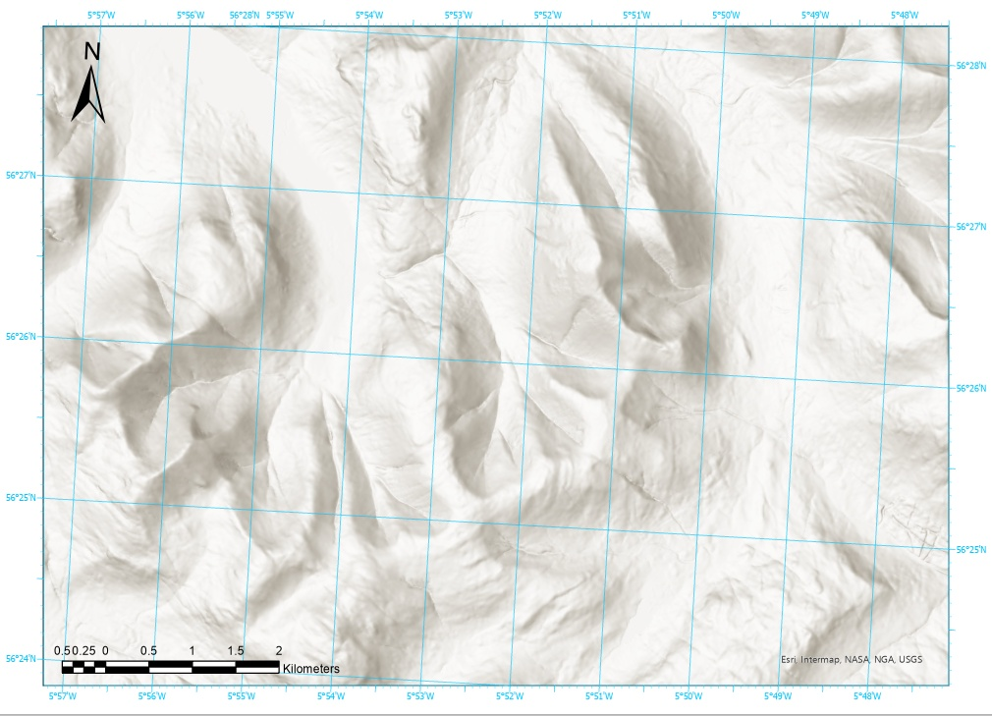
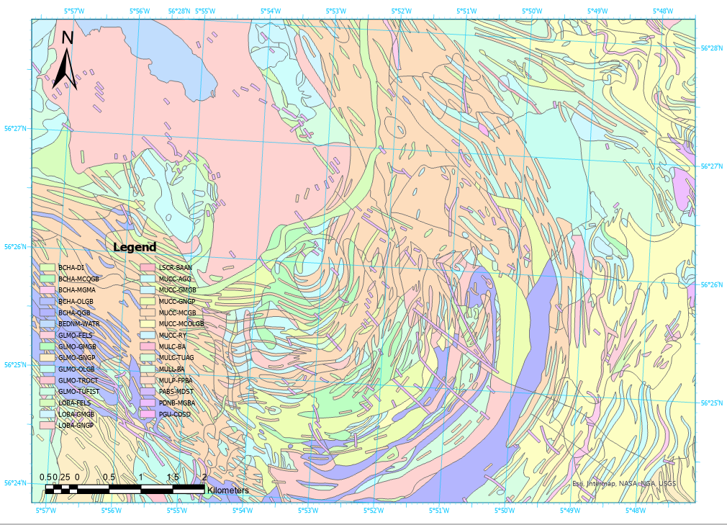
Discrete data
Information assigned to defined values, usually integers.
Can have different functions, but must have defined boundaries.
Counted variable - examples:
  Pets per household
  Town population
Or used to classify:
  Land use
  Geological map unit
  Road type
class | Road type | Symbol
1 | Path
2 | Track
3 | B road
4 | A road

Slide 14
Continuous data
A measured variable that could have any numeric value.
There are no boundaries: values vary continuously.
2D GIS examples:
  Elevation
  Rainfall
  Satellite photos
  Gravity

Slide 15
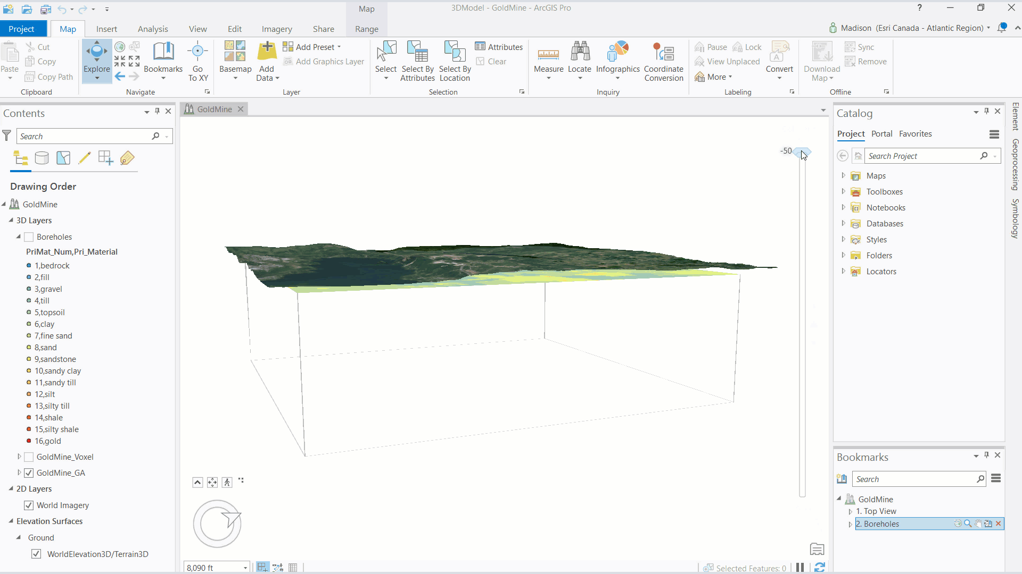
Creating a 3D volume using 3D kriging in Arc Pro
A geostatistical interpolation tool that uses Empirical Bayesian Kriging methodology to interpolate points in 3D
  Kriging: spatial interpolation between point data
  Bayesian: employment of prior knowledge into a calculation
  Here, prior knowledge is an estimation of the semi-variogram and associated uncertainty. ArcGIS iterates, each time estimating a new semi-variogram to close in on the final model.
The tool generates a series of 2D horizontal slices which can be scrolled through
The Geostatistical layers can be combined to create a 3D voxel layer

Slide 16
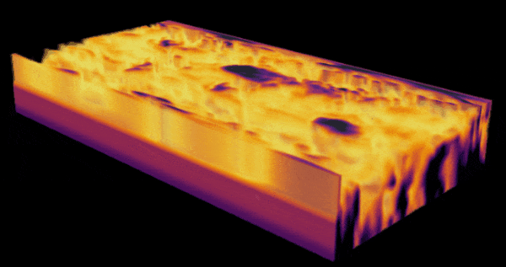
3D visualisation of volumetric data
Volumetric realisations provide a powerful method of visualising 3D data. E.g.
  Subsurface data (e.g. porosity, metal concentration)
  Atmospheric data
  Oceanic data (e.g. temperature, pollutant concentration)
Here – discrete data categories are visualised individually
Esri animation of daily relative humidity with altitude in 2003: ArcGIS Blog

Slide 17
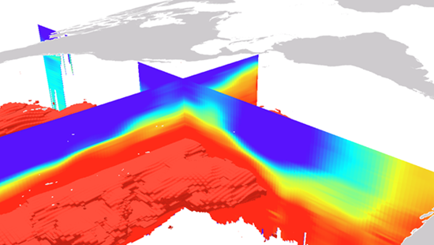
3D visualisations: slices
Oceanic nitrate concentration data
Volumetric data is sliced as:
  2D vertical slices
  Isosurface (a surface created from equal concentration values)
We will be slicing this afternoon
Esri: ArcGIS Pro documentation

Slide 18

Introduction to linked practical
© Natural Resources Wales

Slide 19
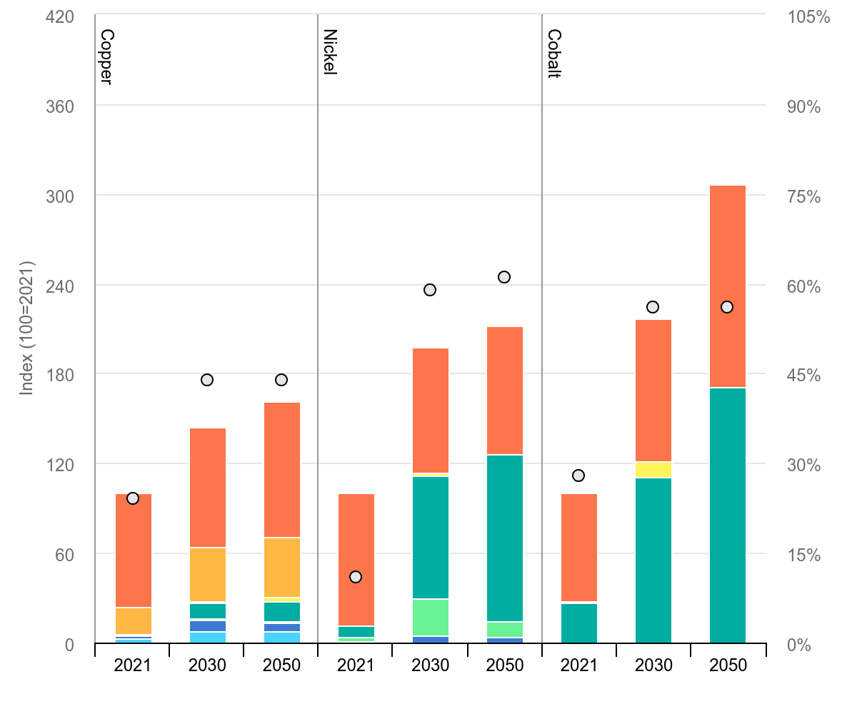
Critical minerals/ metals: projected demand
Copper
Nickel
Cobalt
The expected global demand for critical metals in a net zero world
This can be a dirty business
Other uses
Electricity networks
Grid storage batteries
Electric vehicles
Wind
Solar PV
Other low-energy power generation
Data compiled by the IEA (International Energy Association) https://www.iea.org/topics/critical-minerals

Slide 20
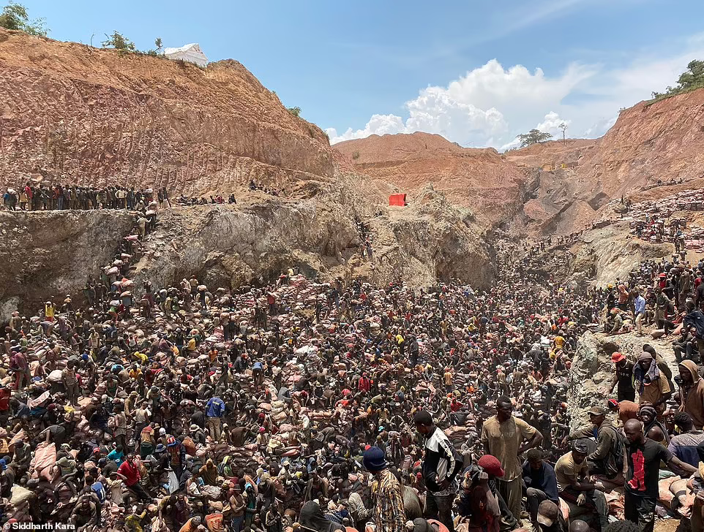
Cobalt – critical for Li-ion battery stability
“Blood cobalt” comes from DRC
Apple, Tesla, Samsung and Microsoft all implicated in cobalt supply chain that extracts minerals using slavery and child labour
Toxicology linked to heart, thyroid, liver, and kidney problems

Slide 21
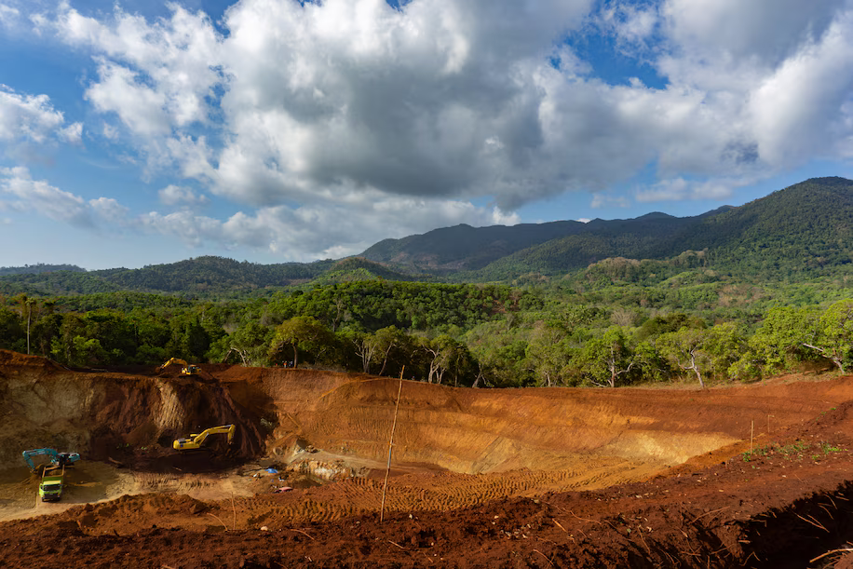
Nickle – cathode in Li-ion batteries
Rain forest destroyed in Sulawesi and Maluku to access Nickle.
Some large scale mining operations are illegal. Large consequences for environment particularly through poor control of waste products and drainage.
Toxicology: causes cardiovascular and kidney diseases, lung fibrosis, lung and nasal cancer. May disturb the human genome.
Is it better for critical mineral extraction to take place in countries with robust environmental policy and government accountability?
© Ian Morse for The Washington Post

Slide 22
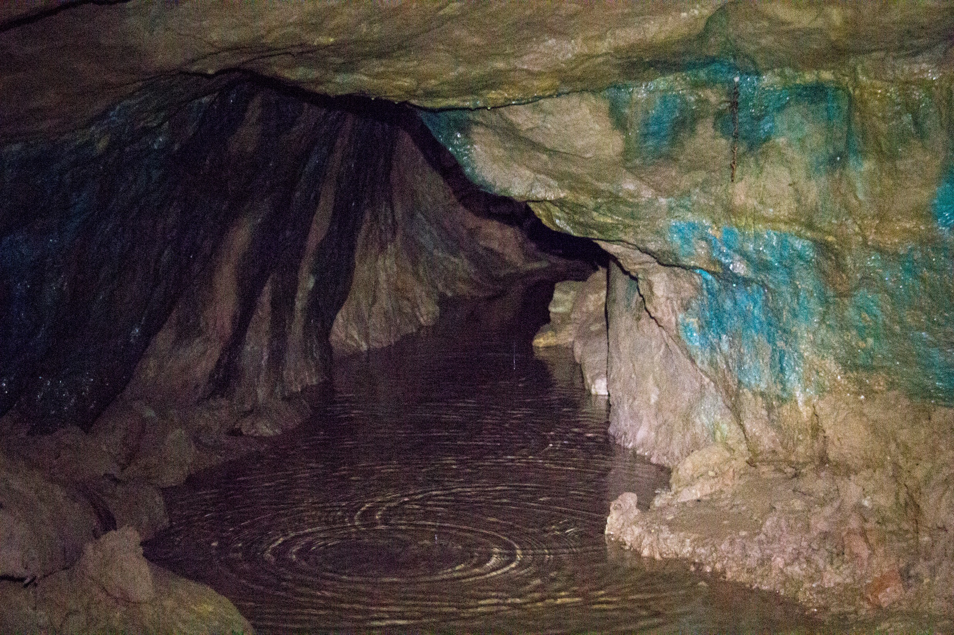
Copper (Cu): critical for all electrical technology
An electric car requires 6x more mineral input than a car running on hydroarbons (IEA, 2024).
MW for MW, an offshore windfarm requires 13x more mineral resource than a gas power station (IEA, 2024).
Should the UK aim for Cu self-sufficiency?
Alderley Edge: Malachite and azurite in the Engine vein.
Photo copyright: Mike Peel, creative commons

Slide 23
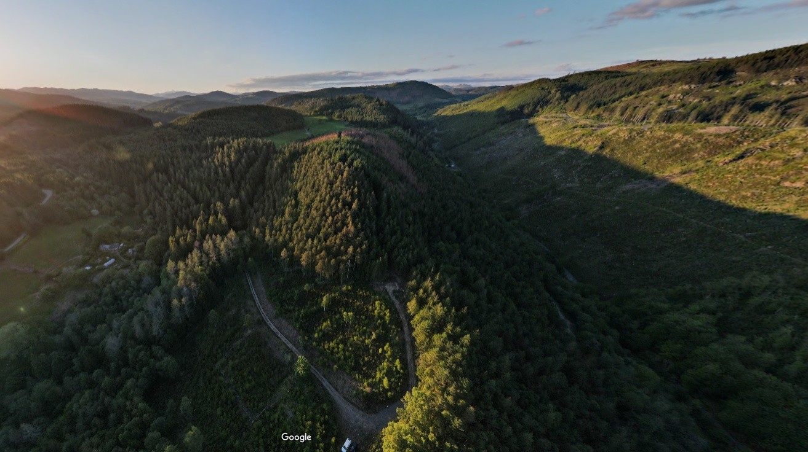
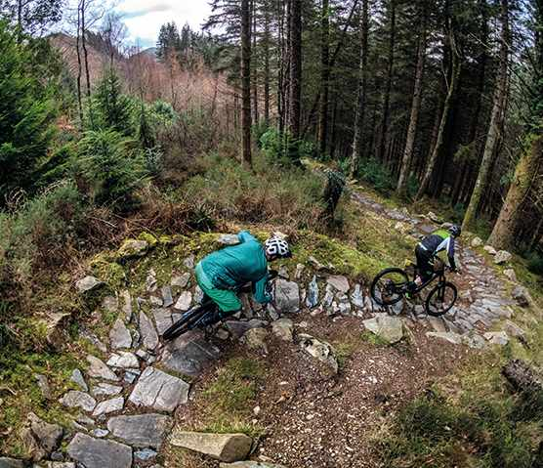
Coed-y-Brenin
Capel Hermon
A large scale copper porphyry underlies this tranquil part of Wales.
Your job is to visualise the copper resource in 3D
MBUK magazine: © Andy Lloyd www.andylloyd.photography

Slide 24
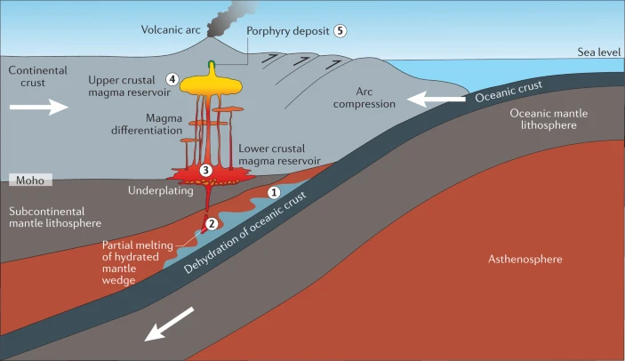
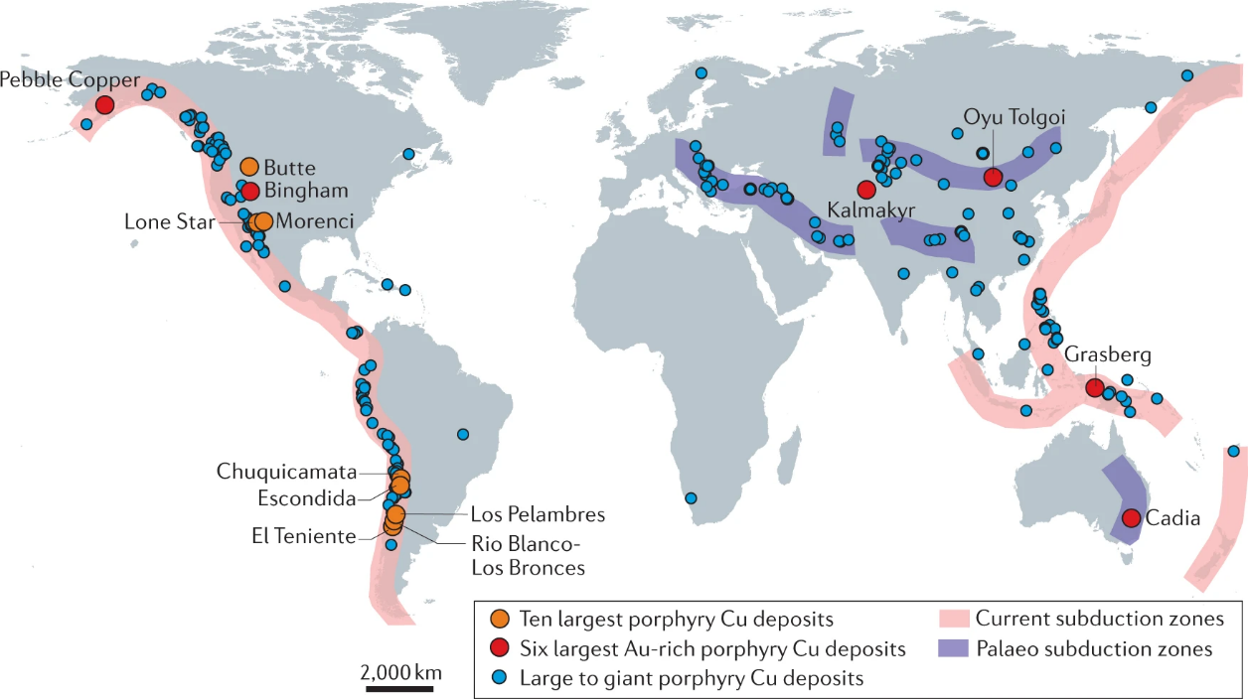
What is a porphyry deposit?
sdsd
Associated with convergent plate tectonics
Downgoing slab sources O₂ rich waters and hydrous melts
Mantle wedge: partial melting in oxidising conditions deplete sulphides. Cu and Au have an affinity for sulphides and are preferentially incorporated into ascending sulphide rich melts
Hydrous basaltic magmas ascend to mantle-crust boundary (30-70km) where magma evolves through fractionation / magmatic differentiation concentrating ore-forming fluids
Rising evolved magmas become fluid saturated as overburden pressure drops
Both figures from: Park et al, 2021
https://doi.org/10.1038/s43017-021-00182-8

Slide 25
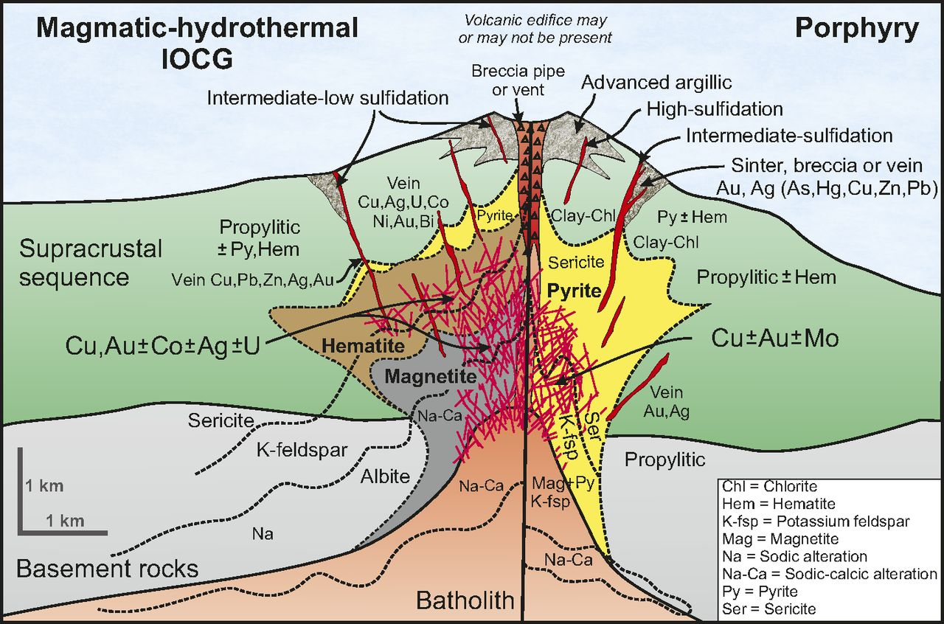
What is a porphyry deposit?
Relative low-density fluids liberated from shallow magmatic intrusions (1-7km) accumulate at top of intrusion.
The high pressure fluids hydraulic fracture (frack) the top of intrusion and country rock.
The fluids condense and cool to a metal rich brine
Metal sulphides precipitated from cooling brines forming halos around the intrusions
Richards & Mumin, 2013: https://doi.org/10.1130/G34275.1

Slide 26
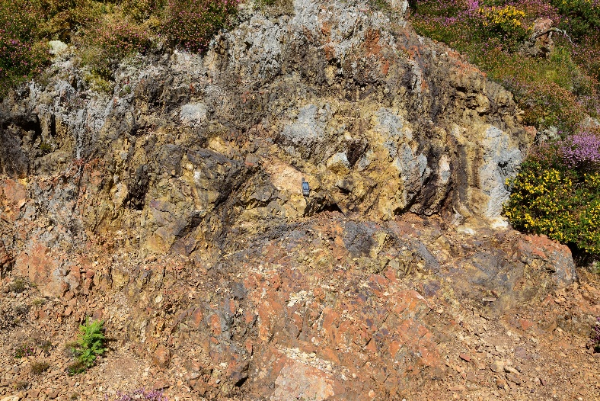
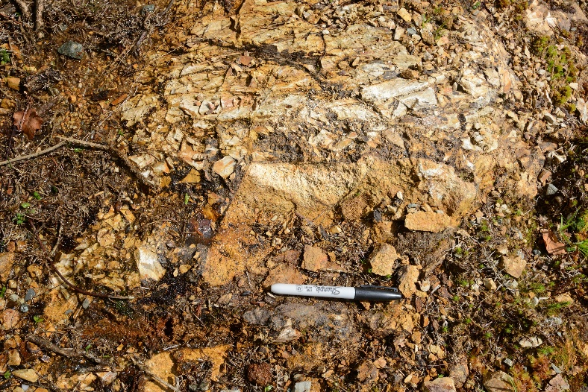
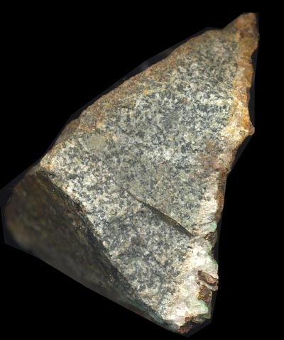
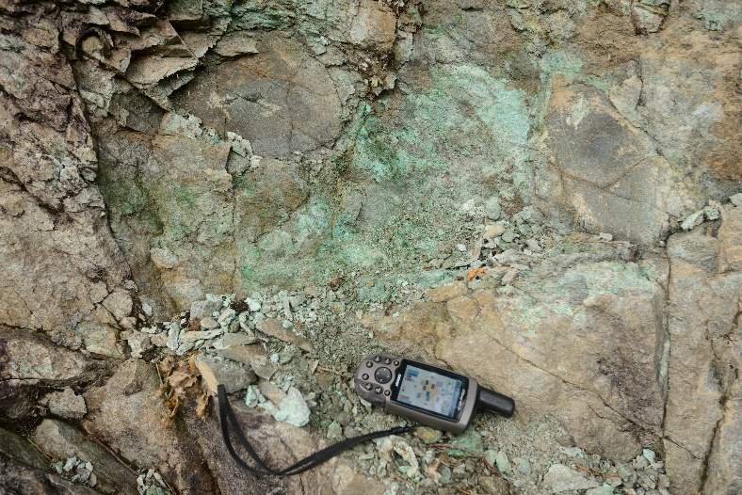
What is a porphyry deposit?
Explosion breccia pipe:
Bleached / shattered Hydrous silica. Sometimes ‘pods’ of copper
Sericitic zone: hydrothermally decomposed microtonalite – here, iron stained – pyrite rich
Microtonalite:
un-altered
Richards & Mumin, 2013:
https://doi.org/10.1130/G34275.1
hydrothermally decomposed microtonalite – here, enriched with copper :

Slide 27
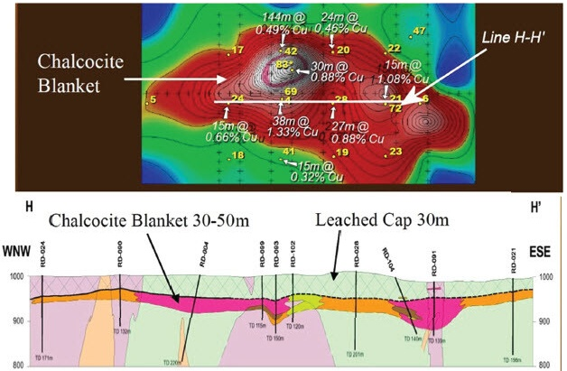
Porphyry enrichment
Porphyry halos are large, low grade bodies: a good one is 1% Cu
Supergene enrichment is a redox process taking place near the surface. It can enrich deposits to >2%
O₂ rich meteoric waters weather and leach metals from the porphyry, and re-deposit in deeper, reducing conditions.
Reko Diq Mine, Pakistan. Electromagnetic survey and interpreted crustal section through enriched supergene (Witherly, 2003: https://doi.org/10.1080/14432471.2023.2287269).
Reko Diq has 5.9 billion tonnes of ore @ 0.41% copper and 0.22ppm gold (0.000022%)

Slide 28
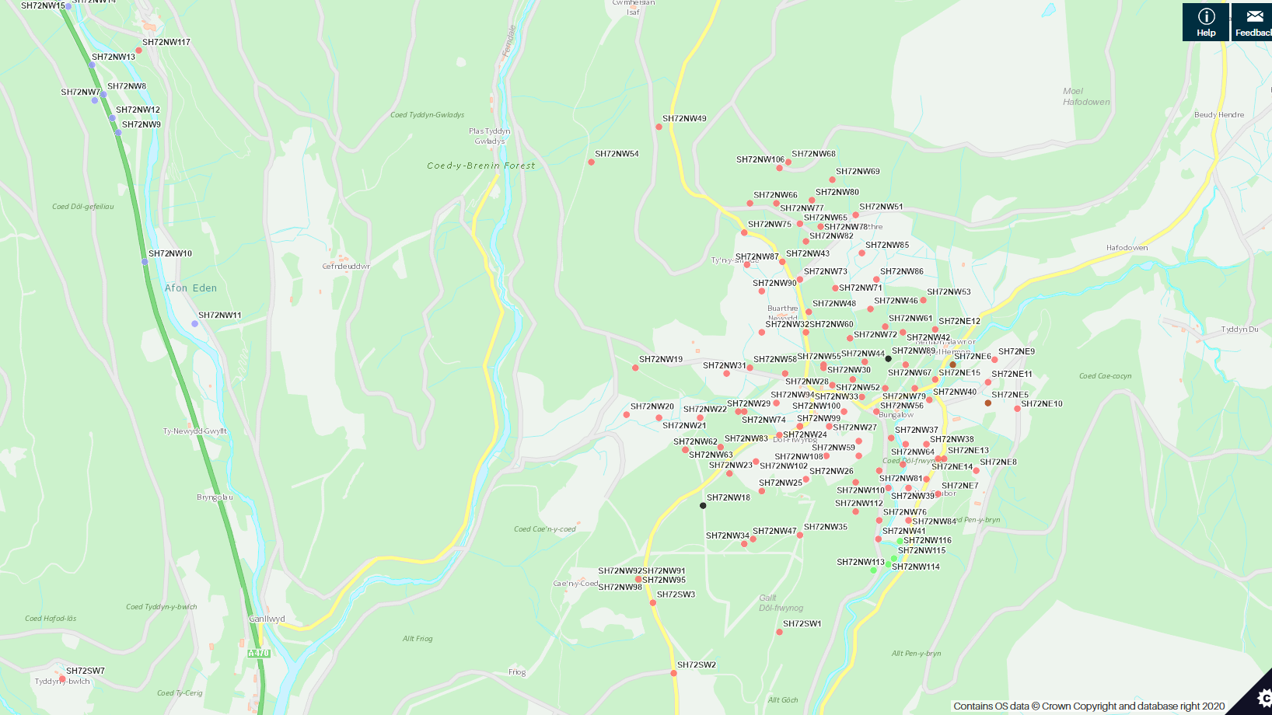
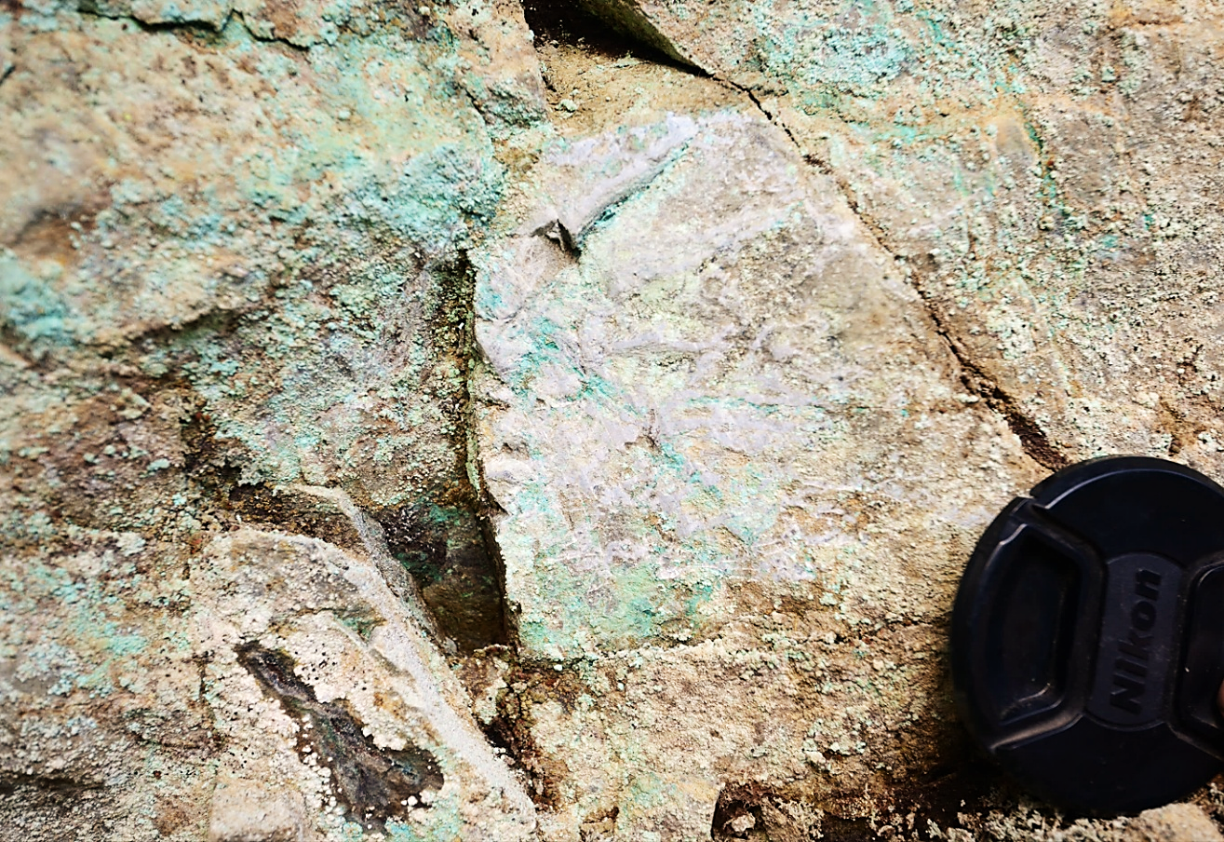
Back to Coed-y-Brenin
Capel Hermon
Greenish oxidised chalcopyrite, disseminated and in fractures

Slide 29
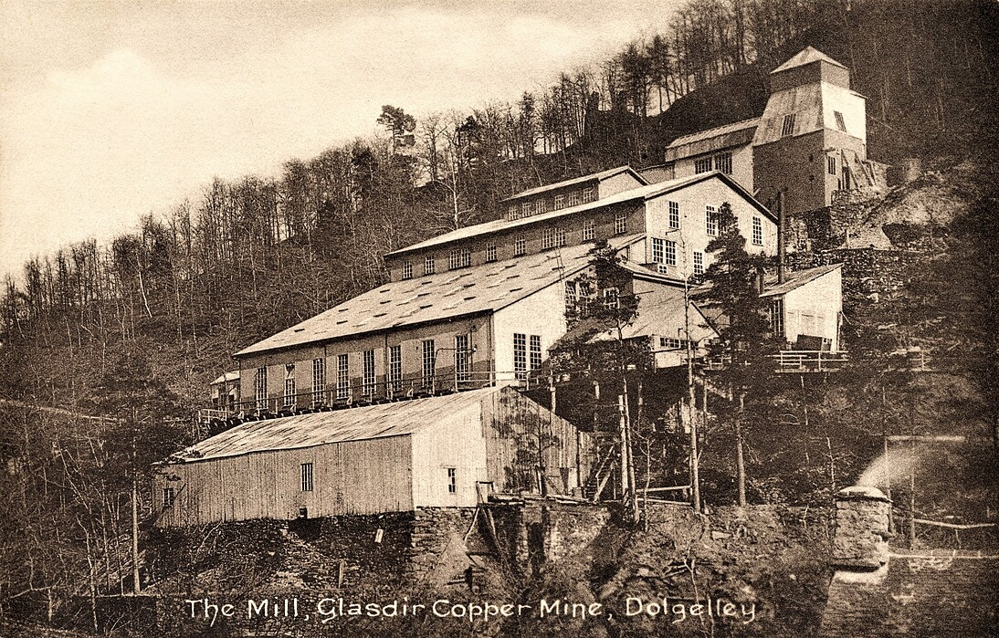
Mining history 1850’s to 1915
Gasdir mine
approx. 1925
Shallow mines produced
13,077 t Cu ore
8275 oz Ag
735 oz Au
Eventually closed due to affects of mine tailings polluting fisheries
© mindat.org

Slide 30
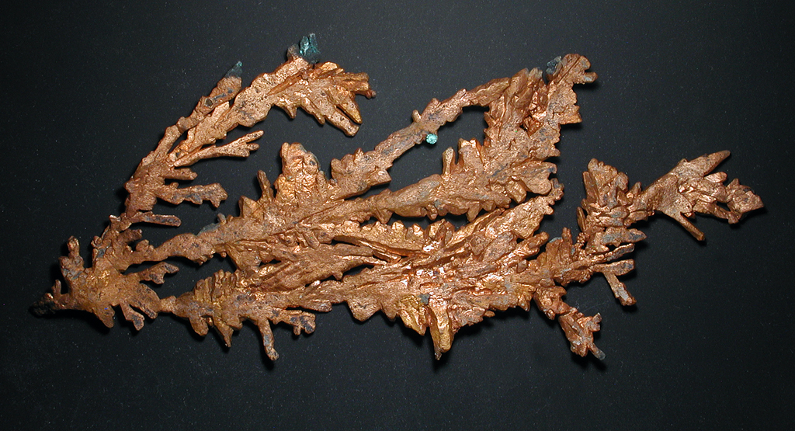
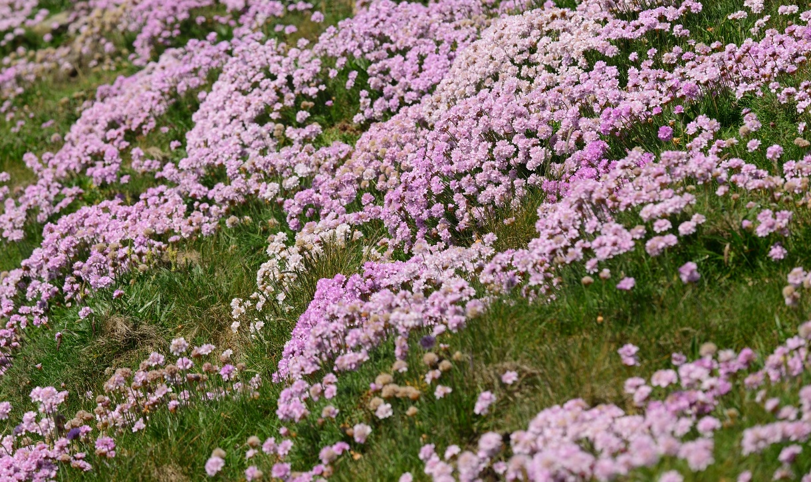
Dolfrwnog Mine and ‘turf’ mine
Very localised supergene enrichment
A redox process: Oxygen rich ground waters percolating through the porphyry reached the surface in a peat bog. Strongly reducing conditions in the peat led to precipitation as native copper and gold.
Peat dug and smelted as ore between 1824 and 1865.
Sea Pinks (Armeria maritima) tolerant of metals, including copper
Probably looked something like this (from Minedat.org)

Slide 31
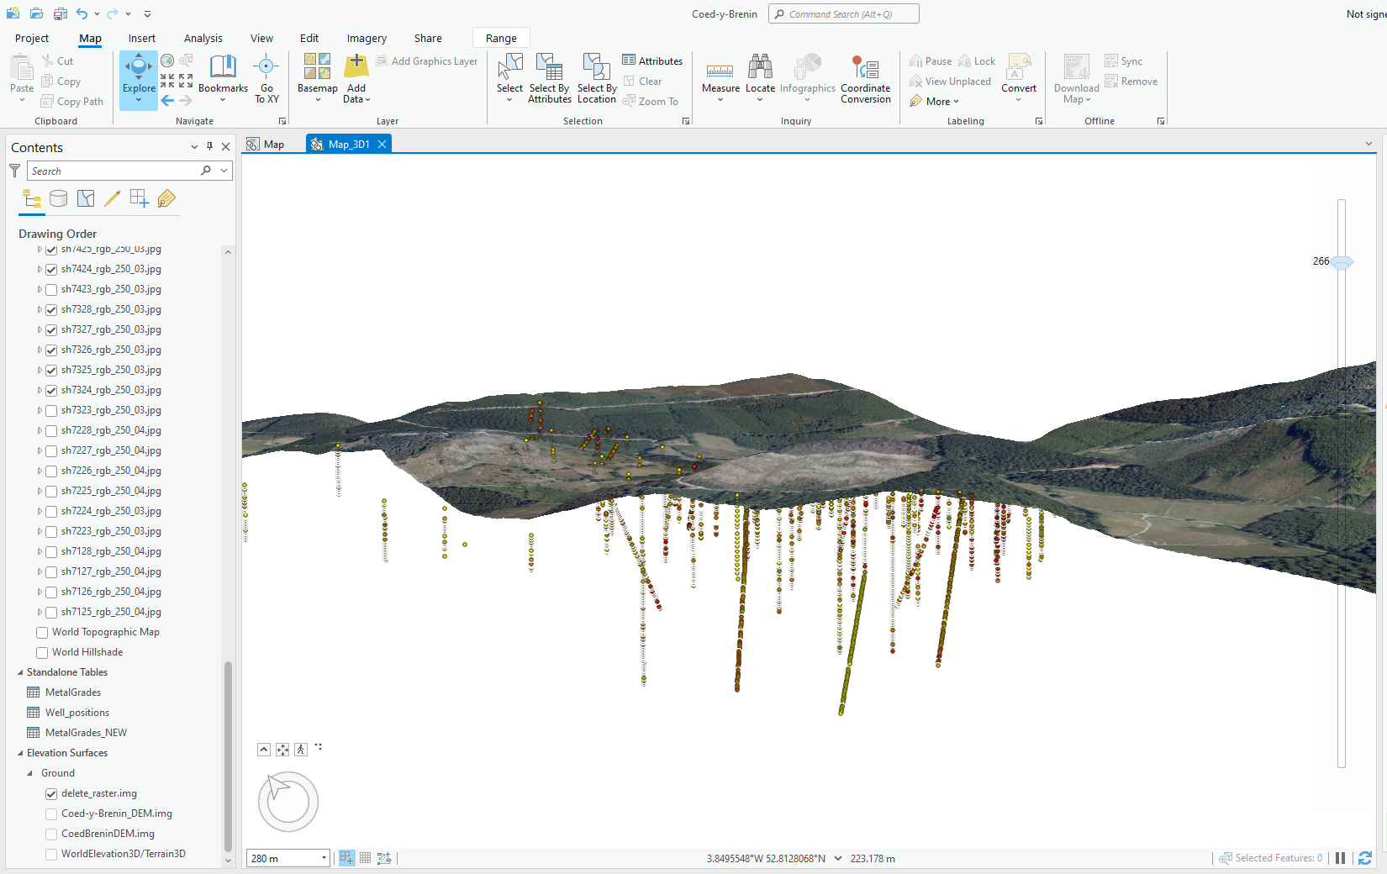
Coed-y-Brenin data
Series of exploration wells drilled in the 1970s
Well data has been input to an Excel spreadsheet
Describes Cu content as well as other metals

Slide 32
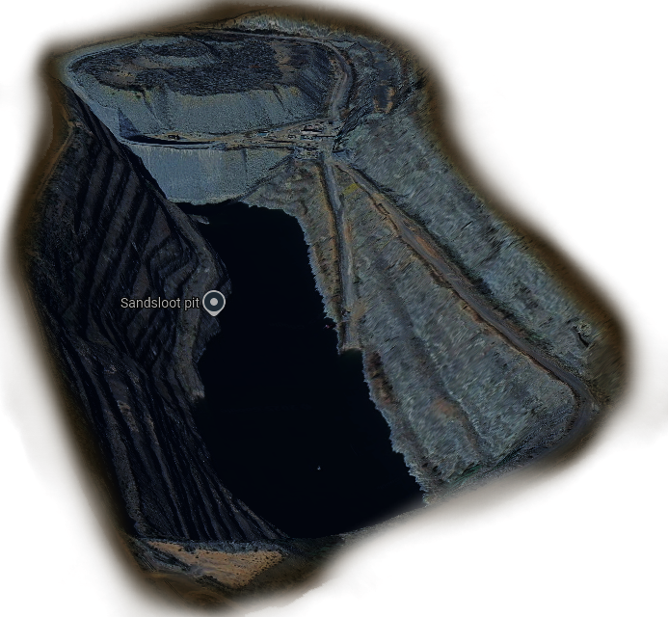
Would you dig up Eryri (Snowdonia) to access it?

